Slide 1
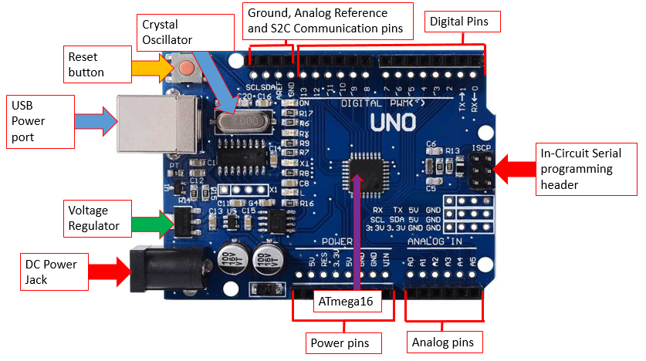
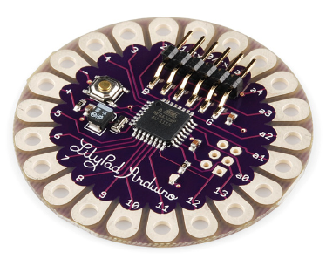
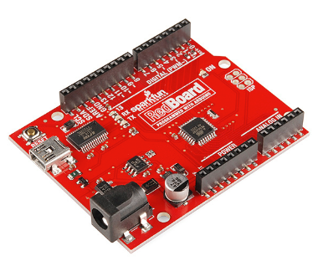
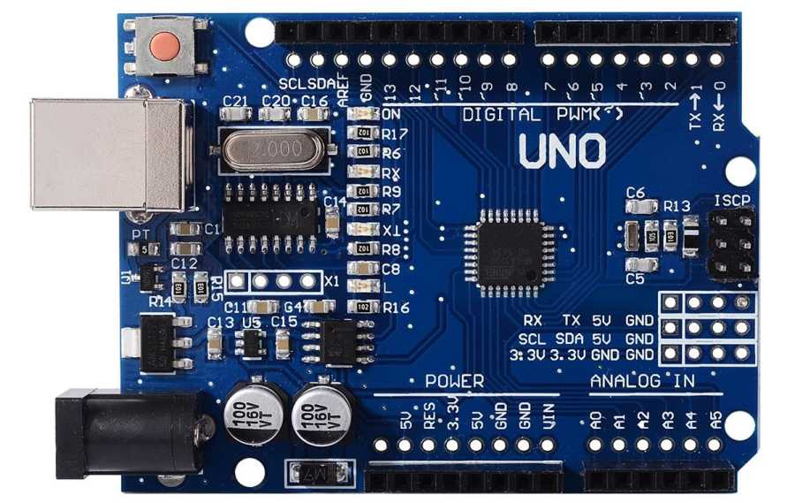
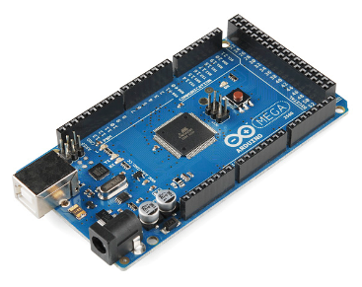
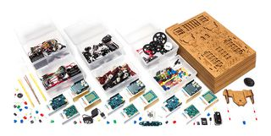
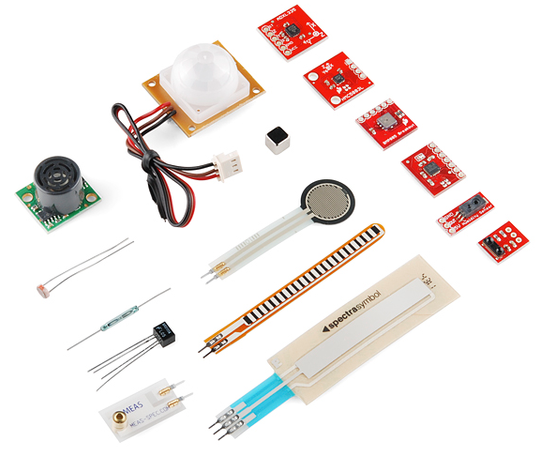
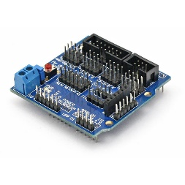
Arduino- Board and Hardware
The Arduino board as described by the Arduino website; ‘the best board to get started with electronics and coding. If this is your first experience tinkering with the platform, the UNO is the most robust board you can start playing with. The UNO is the most used and documented board of the whole Arduino family.
The Arduino UNO is not the only Arduino board, there are many other boards and designs, such as the following boards; the Lilypad Arduino, the RedBoard and the Arduino Mega
This is the Arduino UNO R3 ATmega328P CH340G as seen on the Maker labs electronics’ website.
Specifications include: Microcontroller: ATmega328
Operating voltage: 5V
Input voltage (recommended): 7-12V
Input voltage (limits): 6-20V
Digital I/O pins: 14 (of which 6 provide PWM output)
Analog input pins: 6
DC current per I/O Pin: 40 mA
DC current for 3.3V Pin: 50 mA
Flash memory: 32 KB of which 0.5 KB used by bootloader
SRAM: 2 KB
EEPROM: 1 KB
Clock speed: 16 MHz
The Arduino Lilypad is a unique flexible and wearable board with conductive thread, stated even to be washable.
The RedBoard made by SparkFun whilst not too technically different, provides an aesthetic alternative to the blue of the traditional Arduino UNO boards
Annotated image and diagram of the hardware components and features of the Arduino Uno. It can be seen through this image the various pins and components within the Arduino the functionalities of the Arduino Uno. The range of functionality attributes to the creative initiative the Arduino boards and products provide.
The Arduino Mega provides many more pins and functions as a much more capable board with more functionalities.
The Arduino Education kit provides many boards, jumpers and electronic components, it is a kit that provides the foundations for many projects to be made for hobbyists and student alike.
There are more extensions and capabilities to the Arduino boards however, sensors provide much more functionality to the Arduino and therefore make the Arduino’s much more useful. Some of the sensors as shown on the left detect; light, ultrasonic sound, temperature, humidity and much more. More pins and extensions can be added via the shields for the Arduinos, they connect the Arduino to more functionalities and hardware components The shield on the right is the shield for the Arduino R3

Slide 2
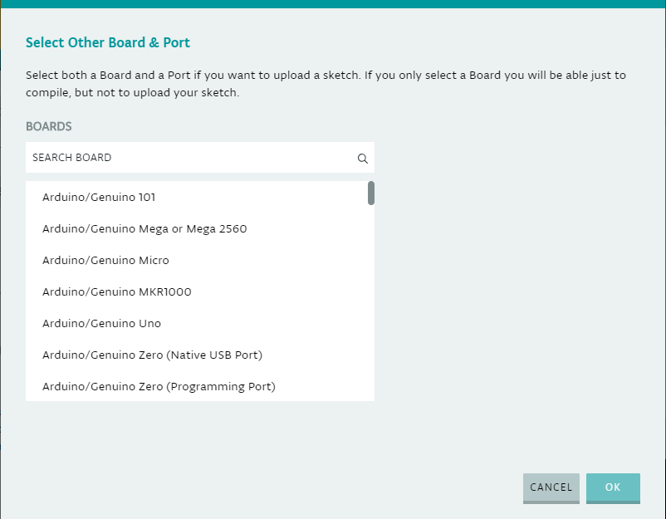
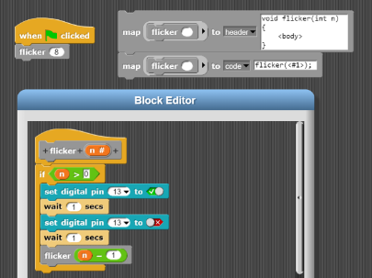
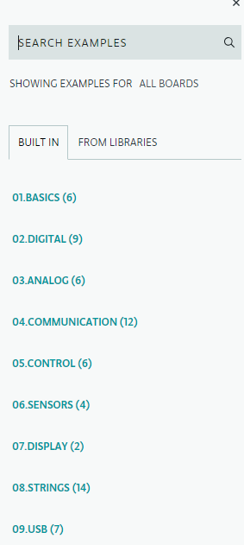
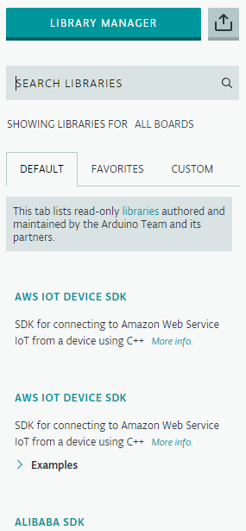
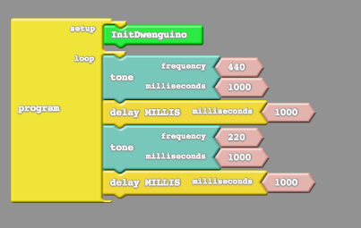

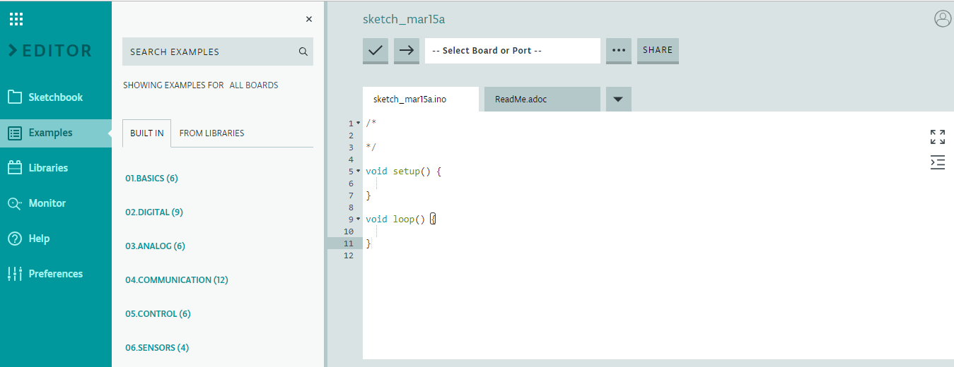




Arduino IDE and Software
All Arduino boards that can be programmed using the IDE. This UI demonstrates a scrolling menu with a search function to differentiate and find the board suited for programming.
Hardware is infamously only one half of a digital solution, and is useless without software. The Arduino IDE and code is integral to the functionality and purpose of the various Arduino boards.
Arduino offers an open-source platform and there is much information for users to learn from therefore making the Arduino brand and boards one of the most user-friendly experiences.
Learning languages such as C++ are beneficial in unlocking the true control and capabilities the hardware components of the Arduino offer. And as seen in the proceeding ‘Intelligent Systems’ slide, there is immense capability and creative potential for the Arduino products.
The Arduino is not just limited to being programmed in a terminal/character environment, There are graphical alternatives for developers also in the form of ArduBlock and Snap4Arduino. The pictures demonstrating the interfaces (Snap4Arduino above and the ArduBlock interface) demonstrate the block development seen in IDE such as block.ly with the Microbit.
This feature amongst the UI of the Arduino IDE displays the vast libraries created from the open-source platform and is testament to the creative potential of the Arduino.
The UI even accustoms for selection of favourites and customs from the libraries one may find from the search functionality. With libraries languages such as Python and C# can be used.
Arduino features an IDE that allows for use of various languages. There is a terminal where users can write in C++ to write their programs for the Arduino boards.
Python is also available to be used for Arduino for those developers specialised in Python. With the communication to the hardware being through serial input, using pySerial, there is much information on their website on how to perform the task.
Attributing to the educational prospects of the Arduino brand, the Arduino IDE presents a window in the form of the ‘Examples’. The examples present much educational material for Arduino developers to adopt and analyse.
C++ is a very popular programming language. C++ is a C-based language variant that uses object-orientated language. C++ as a general language is fast in executing and gives much control to the developer. It is integral to the Arduino as it is was is used in their IDE.
Development for strictly Microsoft developers (in knowing only C#) exists also with the Arduino. Using ‘CmdMessenger’, communication with serial inputs can be used with different languages and can even be ran in Visual Studio with C#.
Involt is a website/ service that uses the Arduino for HTML/ CSS prototyping. It provides UI prototyping with a branch to hardware in being the Arduino. It uses HTML/ JavaScript to control the Arduino using such methods as PWM with JavaScript elements such as Range-slider.

Slide 3
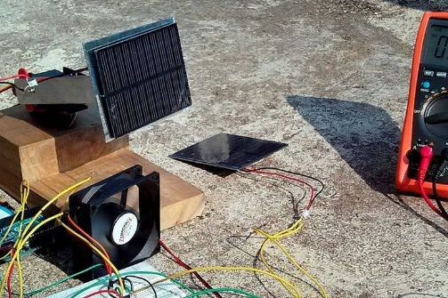
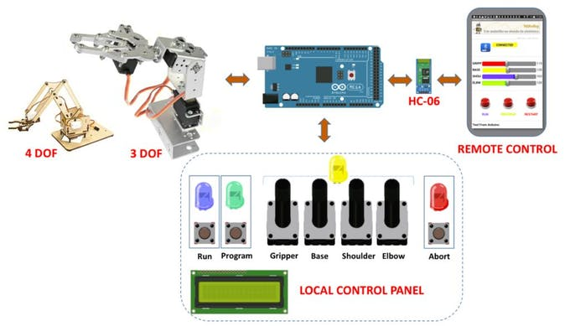
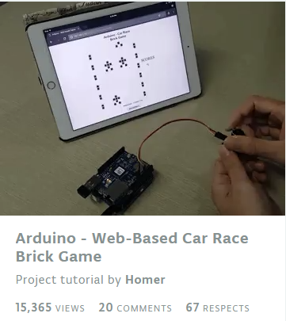
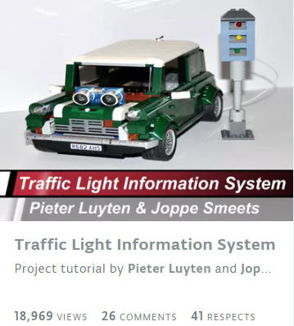
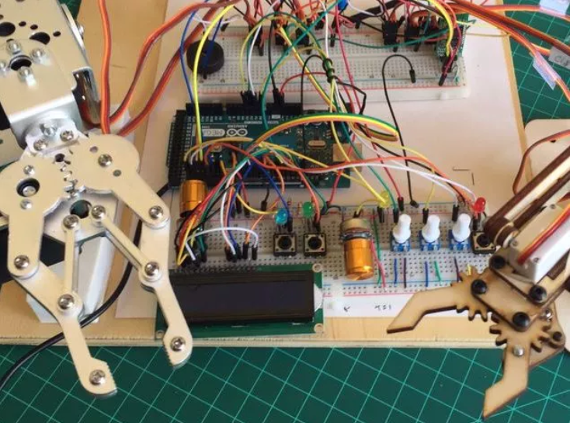
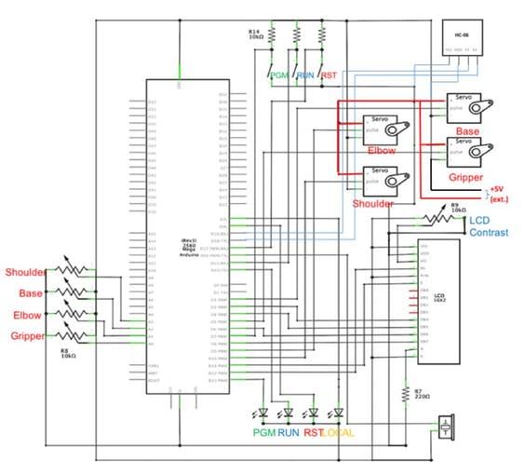

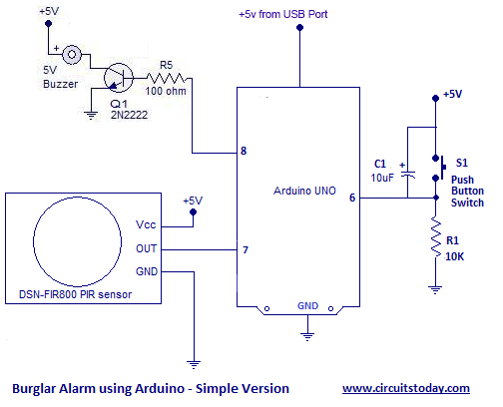
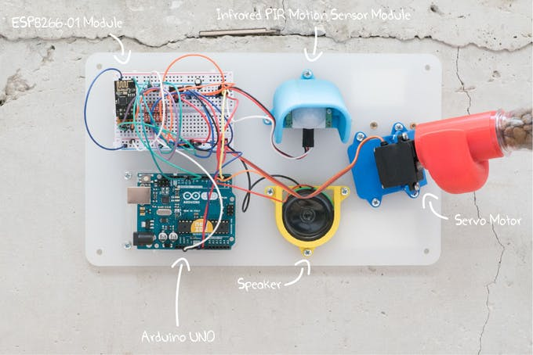
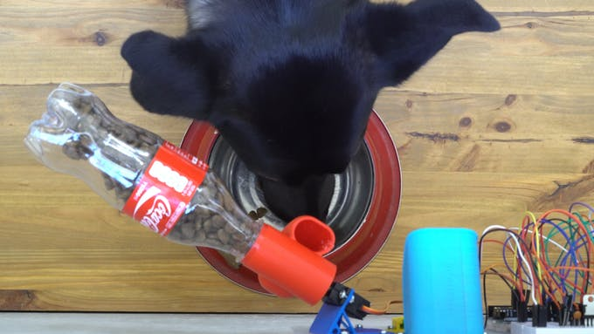
Arduino Intelligent Systems
This Arduino is being used for solar tracking, connected with a solar panel and displaying the solar statistics found on the solar panel. This conveys an insightful approach as how computation and programs can be used to collect real life data
The point of the Arduino board and products is that they provide kits and functionalities that are meant to encourage creativity and highlight the usefulness and resourcefulness of technology.
The open-source nature of the Arduino benefits the Arduino community to where they can learn from Arduino projects across the community whilst sharing their own projects.
Intelligent systems are determined by the complexity of the project. Whilst computers are not inherently intelligent, with the use of software and extended hardware components such as sensors and rotaries.
This Arduino is used for programming robotic arms, this is an example of further complexity in this intelligent system. This system uses a remote control app similar to other solutions, to control the movement and rotations of the hydraulic arm. The source website offers much complexity in how to build the hydraulic arms, to how the circuits are configured on the Arduino board, to how the solution is connected wirelessly. The overall solution is demonstrated in the first picture (upmost), highlighting the full flow-chart, the second picture is the hydraulic arms connected and the third picture gives insight in the complexity in being the diagram used to describe the circuitry needed for this solution
The following image on the left shows the circuit frame for a ‘Burglar Alarm using Arduino’. This project uses such hardware devices as PIR sensors; that identify movement using infrared red motion detectors under it’s range. Buzzers are used for sound when triggered using various transistor configurations. Switches are used also to reset the alarm. The image on the right shows the code demonstrated on the website. This code being C++, the primary language of the Arduino
The Arduino website provides itself many projects that can be made with their products. There is a list of over 200 insightful projects in which it can be used. The website provides coherent descriptions on examples such as: a traffic control system and a web-based car race game with the Arduino used as a controller.
int sensor=7; //The output of PIR sensor connected to pin 7
int push_switch=6; // push button switch connected to pin 6
int buzzer=8; // buzzer connected at pin 8
int sensor_value; //variable to hold read sensor value void setup() { pinMode(sensor,INPUT); // configuring pin 7 as Input pinMode(push_switch,INPUT); // configuring pin 6 as Input pinMode(buzzer,OUTPUT); // configuring pin 8 as OUTPUT }
void loop() { sensor_value=digitalRead(sensor); // Reading sensor value from pin 7
if(sensor_value==HIGH) // Checking if PIR sensor sends a HIGH signal to Arduino { digitalWrite(buzzer,HIGH); // Activating the buzzer } if(digitalRead(push_switch==HIGH))// Checking if pushbutton was pressed { digitalWrite(buzzer,LOW); // turning OFF the buzzer }}
Another project made with the Arduino is a pet feeder. It features a turning bottle of pet food that turns when activated via an app displacing the pet food into the pet’s bowl. This is a prime example of IoT as it uses the app as the hub of the project to activate the pet food. The app is created and coded on freeboard which specialises in IoT projects. It can be seen on the left the system of the project (which can be elaborated on the source website) and on the right and above the freeboard icon, and below a dog eating from the bowl below the intelligent system.

Slide 4

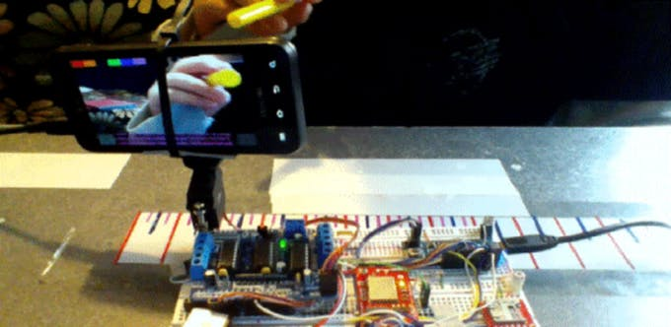
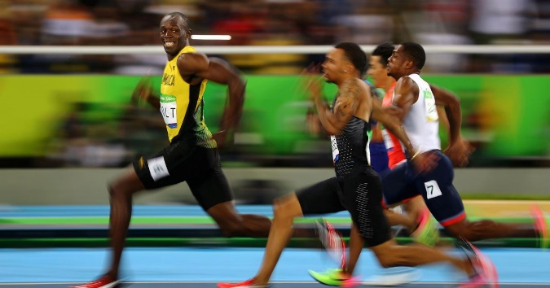
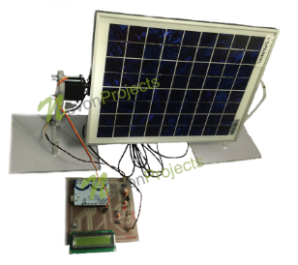
Case Study- Intelligent Systems
Run the application and select Wi-Fi in menu for registration of target host and port where information will be sent to Arduino
This flow chart shows the client instructions/ step for the solution. The result of following these steps will be the Arduino solution.
The case study used for the assignment will be one found on the Arduino projects page. Labelled ‘IoT Arduino ball tracking’, this project in basic terms has a phone that rotates to the position of the ball relative to the camera. It also tracks specific characteristics of these objects, namely the colour and shape.
These algorithms application to real life can be used in sports such as tennis, where a high speed camera may follow a ball to track its movement in cases where it is needed, such as the image to the left which is an example where camera analysis is needed to determine where the ball landed.
As demonstrated by QCAA, the way to develop a digital solutions are outlined by the following steps;
Understand the constituents of a digital problem by restating and summarising.
Analyse the human need or want.
Decompose the problem by breaking the problem down into parts.
Identify essential elements.
Recognise constraints.
Select which colour the technology is to track. When this colour is detected, information will be outputted with position, colour and shape
Through the Wi-Fi module, the Arduino receives information through the UDP sockets client server from the Android application
https://youtu.be/VB7H6rotAWM
The above image demonstrates the finished digital solution, with the phone rotating to the position of the spherical object (the yellow cylinder held by the hand appears as a circle/ sphere in the 2D camera.
Steps to approach a digital problem
Another example of a practical application is the speed cameras tracking the sprinters as they run their respective races.
In the steps to approach a digital problem, the QCAA textbook demonstrates the EDGE method being; Explore, Develop, Generate and Evaluate.
Although in being an investigation case study task, the explore stage will be the only necessary stage. The explore stage is decomposed of separate steps as follows in the box to the right.
Restate the problem; concise bullet points
Explore a human need or want; understanding the want of a human by researching solutions and establishing target audiences.
Decompose (break down); decomposition of digital problem into solvable and smaller problems
Identify requirements
Recognise restraints
Restate the problem
Identify requirements
This final project example has a rotating solar panel based on the intensity of the sun on each panel. This would save much power and thus make solar panels much more efficient
Explore a human need or want
Recognise restraints
Decompose (break down)

Slide 5
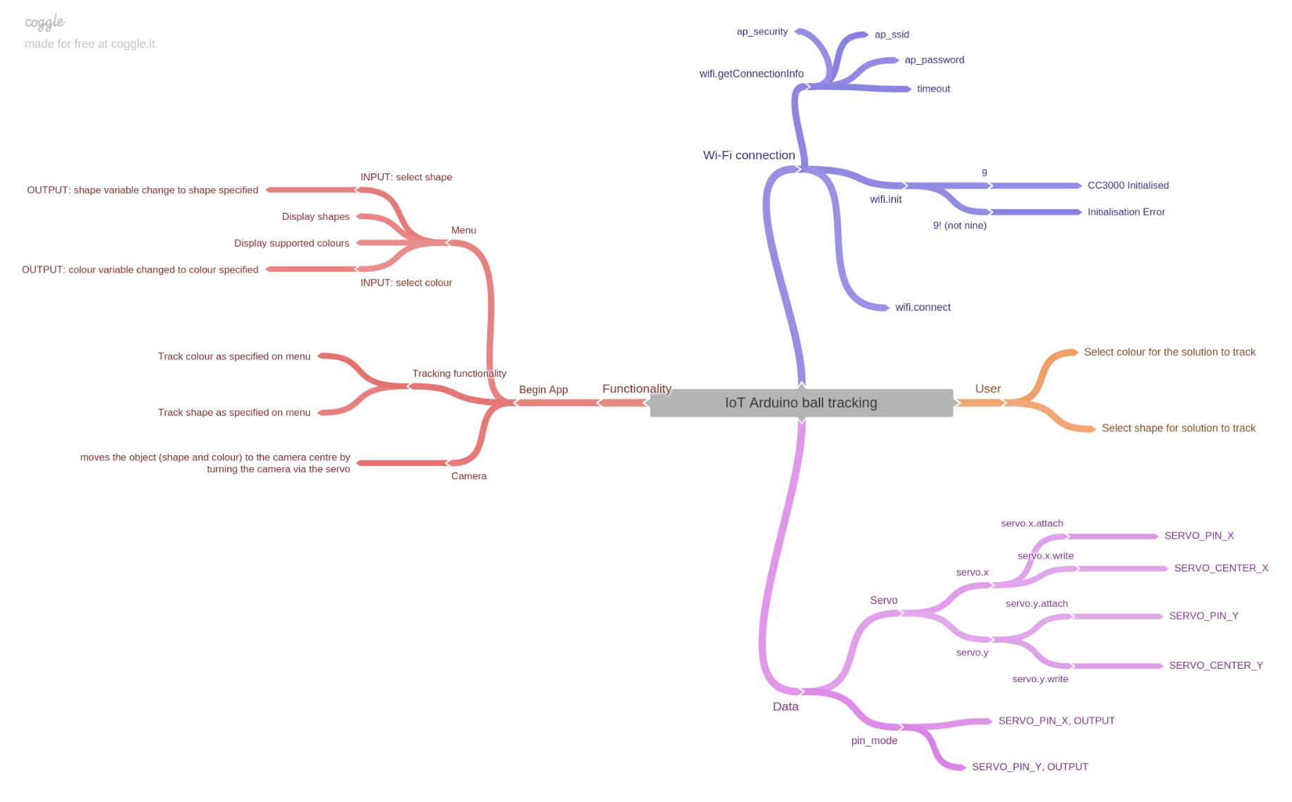
Case Study- Intelligent Systems
The first step of the problem solving process is restating the problem. The problem solving process will be outlaid on the following A3 slides from left to right columns,
Explore a human need or want
To explore the human needs and wants, a mind map was used to map aspects of the solution. This mind map conveys such considerations to the task as the user control and interface, to the data stored to the functionalities of the solution. Much of the ‘Data’ and ‘Wi-Fi connection’ sections were used from the code which is referenced in the A4 Annotated codes sheets and the source Arduino page. This section is continued in the following A3 slide
Restate the problem
Create an app that can identify coloured shapes
Use the Arduino and it’s computation and connect it to an app
Simple and easy-to-use UI for app
Have a code that does not waste memory (is as efficient as possible)
Solution that is easy to setup for other hobbyists and developers alike
Explore a human need or want
The human needs or wants are more limited in the case of the Arduino solution, as there is less user accessibility and control as opposed to a digital solution such as a web app or game, however the main human need or want that can be elaborated in this case is;
- To satisfy the requirements of the solution; perform the tasks as described in the first aspect of solving a digital problem; ‘restating the problem’

Slide 6
Case Study- Intelligent Systems
Explore a human need or want
Input (Data) | Process (Hardware) | Output (Action)
A user selects a colour for the shape that is wanted to be tracked. | This data is stored in the app and transported using the UDP sockets client server. Using various Wi-Fi functions and blocks of code, the Arduino can automate the Servo to respond to the data given. | The phone moves horizontally in order to centre the object described in the input
Decompose (break down)
Identify requirements
The requirements of the digital solution are listed in the box below.
Through decomposition of the solution, the solution can be expressed as;
Wireless connection; importing the specific libraries needed and using the hardware needed
Functionality; Analysing and generating the correct inputs and outputs for the user
User interface and control; deciding what the user can do with the app and how it is functions with the user at control
Data; What data variables need to be considered and how they will be stored.
Hardware components and configuration to be able to effectively turn with the servo
Arduino code effectively used to configure servo as required
Arduino code imported relevant Wi-Fi configurations in order to link to app
App has effective UI design and connects with Arduino
Response to user input and efficient use of storing the user input (data)
Recognise restraints
Decompose (break down)
Identify requirements
Servo mobility; the servo can only rotate horizontally, if the object which the Arduino is tracking is taken out of the vertical view, the solution cannot track that object.
Wi-Fi dependence; without Wi-Fi connection the solution cannot work
Hardware components; the range of hardware components may be inaccessible at certain times during school or outside school (given the equipment is in school)and thus eliminates testing and development time
Decomposing of the problem helps make the problem-solving must easier to handle given a smaller workload. It also gives clarity and simplicity to the digital problem as a whole. The aspects of this digital problem can be evaluated from the previous step’s mind map also, which helps identify and highlight the features and key aspects of the solution.
In this digital solution there are restraints which limit the potential to which the solution can function. In particular given that the intelligent systems in based around hardware, there are hardware components which cannot function to the full extent human needs or wants may specify.
Identifying the requirements of the solution involves outlining the content of the previous steps and giving statements on how these goals and problems will be achieved.

